Slide 1
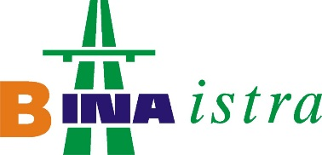

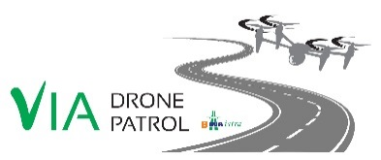

DRONES – AN ADDITIONAL SAFETY MEASURE ON THE ISTRIAN Y MOTORWAY
Bina-Istra Operation and Maintenance
Christian Santaleza
46TH ASECAP Study & Information Days
Ljubljana, 6-8 June 2018

Slide 2
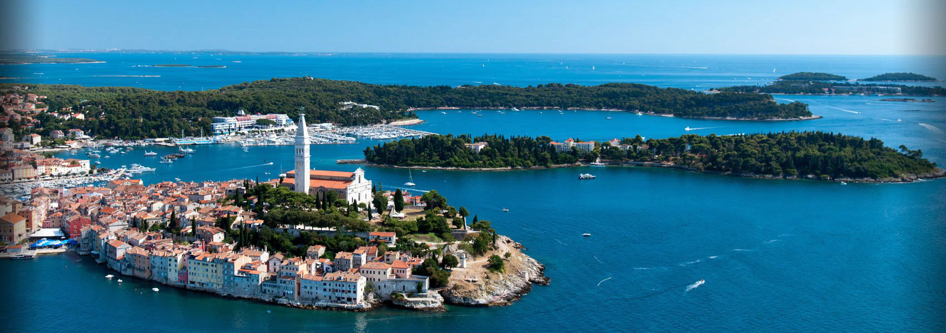

ISTRIAN Y MOTORWAY
100 km motorway + 50 km semi-motorway
Učka tunnel (total length >5 km, bi-directional tunnel)
136 structures, total length 9.35 km
Closed toll system operation with 108 lanes
  Total investment value =
  800 million €

Slide 3
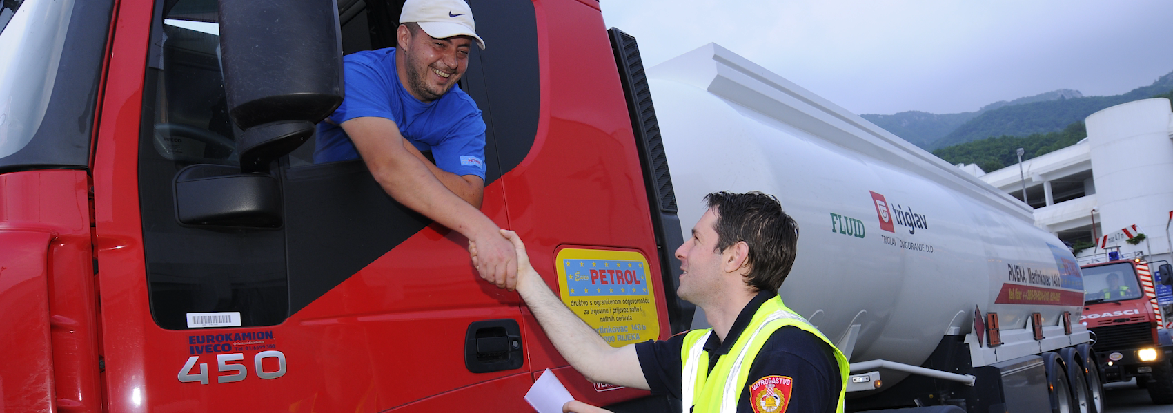
ISTRIAN Y MOTORWAY
AADT of 24,000 vehicles
Peak day traffic of 70,000 vehicles
40% tourist-related traffic volume
  10 million vehicles per year

Slide 4
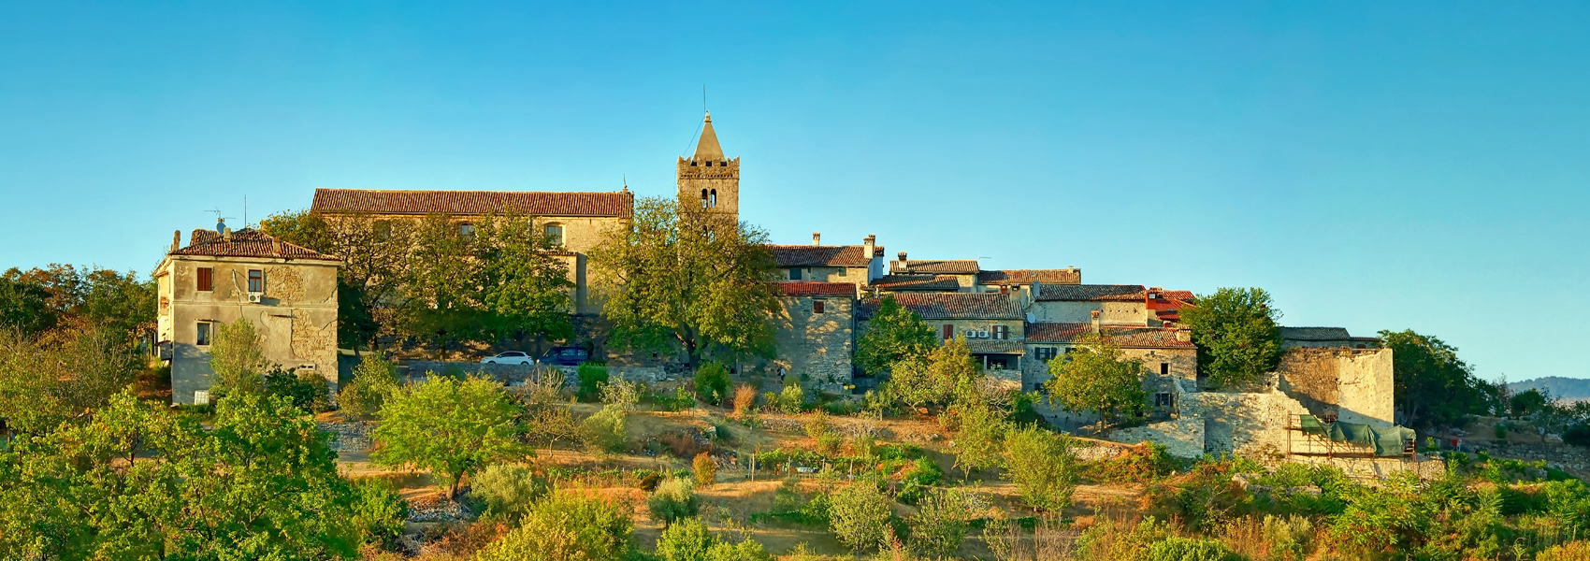
ISTRIAN Y MOTORWAY
+22.0% traffic volume
-12.5% road accidents
In the last 5 years:
0 fatalities in the last 4 years on the motorway
The first motorway company in the Adriatic region certified under ISO 39001 Road Traffic Safety Management
  EuroRAP

Slide 5
For motorway concessionaires, one of the top priorities is:
      Fast detection of events on their networks
Several possibilities are available:
      Video coverage along the entire network
      Implementation of well-equipped and frequent patrol units
On the Istrian Motorway (BINA ISTRA Concession– Croatia), high level of safety standards:
      1 patrol unit per 50 km long section every 4 hrs (2 x more frequent than the local legal requirement)
A danger persists: No network status information / no possibility to detect incidents during 4 hrs.
Solution: use of autopiloted drone to cover the non surveilled period.
Very expensive measures

Slide 6
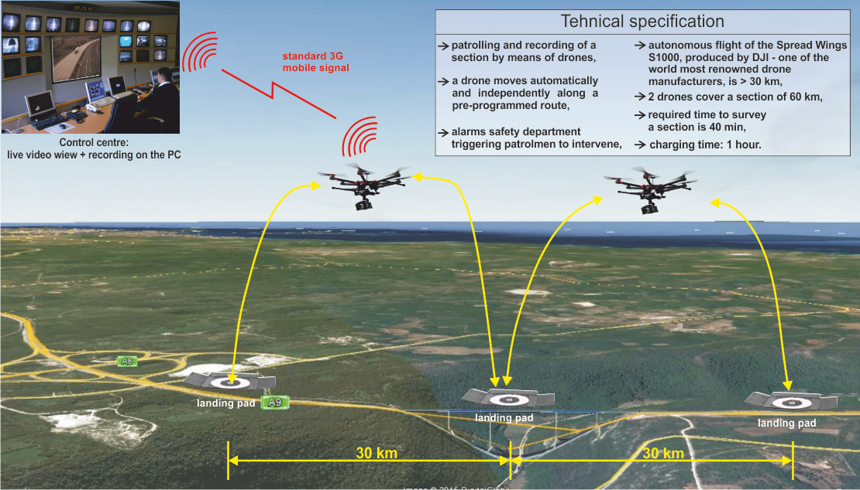

Slide 7

Our researches and preliminary tests enabled us to find the adequate device:
      Very high cost/efficiency ratio
      Available for use day and night
      Surveillance possible also during unfavourable weather conditions (up to wind speed of 45Km/h, which gives device availability of 87% of time)
Bina Istra in-house development of a software interface allowing auto-pilot functions (without human intervention):
      Predefined itinerary within an authorized corridor
      Real-time sending of videos to the Control Room (3G network)
      Possible commands from Control Room: stationary flight, forward flight, backward flight, zooming etc. along the predefined itinerary
      Autonomous landing, charging and taking off, without human intervention

Slide 8
System compliant with the legal framework:
      Flying-over zone is within the land plots owned by the Concessionaire
      No-fly zones are defined in order to avoid for the drone to fly over the Motorway
      Safety system with demarcation lines/if the line is crossed, emergency landing mode is activated
      Procedure of obtaining authorisation for use is ongoing with the civil aviation agency (high possibility of obtaining)
System testing ongoing:
      Preliminary results conclusive/implementation planned for 2018 (over a section of 30 Km).
      Total investment price confirmed: 25,000 Euro.
System easily transposable:
      Longitudinal construction sites (construction of railways, motorway networks,…)
      Enables surveillance, monitoring of construction progress, avoids trips within areas which require systematic control for safety and security reasons.

Slide 9
Thank you for your attention.

