Slide 1
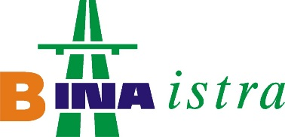
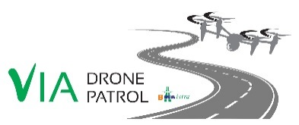
Séminaire Pôle Concessions.
Montpellier, Septembre 2016

Slide 2

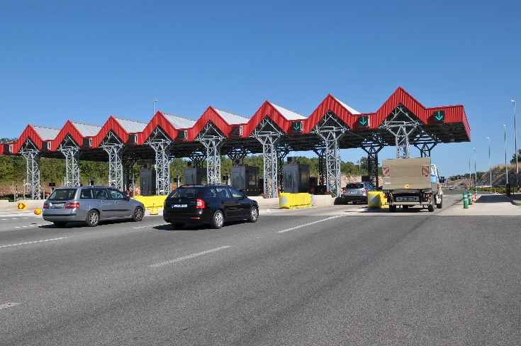
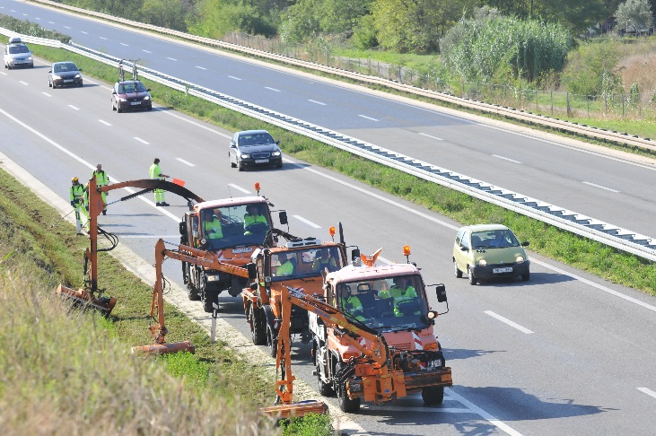
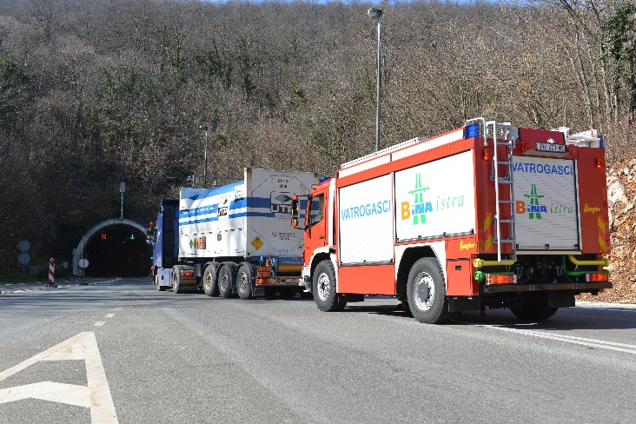
ISTRIAN Y MOTORWAY
100 km motorway, 50 km semi-motorway
Učka tunnel
  bi-directional tunnel,
  total length 5 km,
136 structures, total length 9.35 km
2 maintenance centers
1 control room
Closed toll system operation with 108 lanes
Road and tunnel safety equipment
220 workers
AADT of 24 500 vehicles
Peak day traffic of 64 000 vehicles
55 % of transactions done in automatic mode
20 firemen for the tunnel safety
5 000 assistance/interventions on road by year
O&M yerly cost 51 300 € per Km
  Investment value =
  800 million €
  9 millions of vehicle per year

Slide 3
For motorway concessionaires, there is one priority:
      Fast detection of events on their networks
Several possibilities available:
      Video coverage along the entire network
      Implementation of equipped and frequent patrol units
On the Istrian Motorway (BINA ISTRA Concession– Croatia), high level of safety standards:
      1 patrol unit per 50 km long section every 4 hrs (2 x more frequent than the local legal requirement)
A danger persists: No network status information / no possibility to detect incidents during 4 hrs.
Solution: use of autopiloted drone to cover the non surveilled period.
Very expensive measures

Slide 4
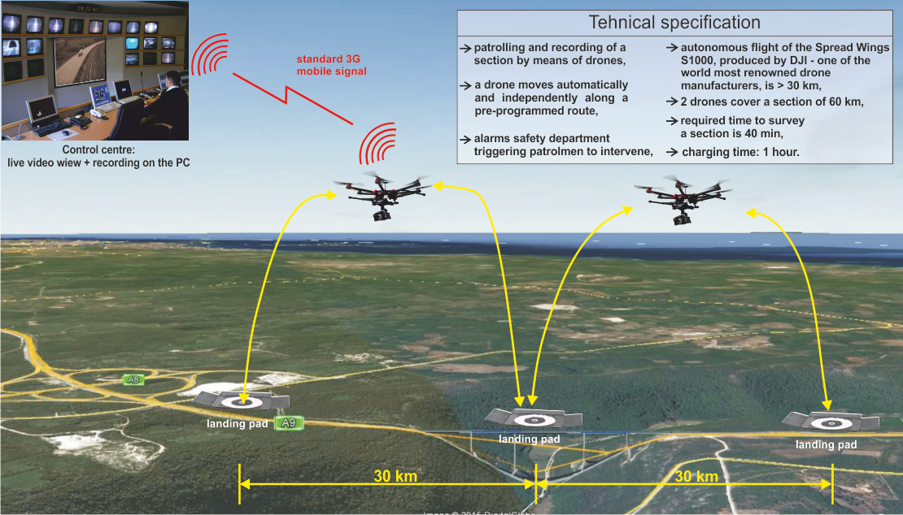
LIVE VIDEO STREAM FROM VIA DRONE PATROL:
https://www.youtube.com/watch?v=bVFu9HLTJJQ

Slide 5

Our researches and preliminary tests enabled us to find the adequate device:
      Very high cost/efficiency ratio
      Available for use day and night
      Surveillance possible also during unfavourable weather conditions (up to wind speed of 45Km/h , which gives device availability of 87% of time)
Bina Istra in-house development of a software interface allowing auto-pilot functions (without human intervention):
      Predefined itinerary within a authorized corridor
      Real-time sending of videos to the Control Room (3G network)
      Possible commands from Control Room: stationary flight, forward flight, backward flight, zooming etc. along the predefined itinerary
      Autonomous landing, charging and taking off, without human intervention
System compliant with the legal framework:
      Flying-over zone is within the land plots owned by the Concessionaire
      No-fly zones are defined in order to avoid for the drone to fly over the Motorway
      Safety system with demarcation lines/if the line is crossed, emergency landing mode is activated
      Procedure of obtaining authorisation for use is ongoing with the civil aviation agency (high possibility of obtaining)
System testing ongoing since March 2016:
      Preliminary results conclusive/implementation planned for October 2016 (over a section of 30 Km).
      Total investment price confirmed: 15,700 Euro.
System easily transposable within Bouygues Construction:
      Longitudinal construction sites (construction of railways, motorway networks,…)
      Enables surveillance, monitoring of construction progress, avoids trips within areas which require systematic control for safety and security reasons.

